Slide 1
Creating, Submitting, and Viewing Genedata Biosensor Request: A Step-by-Step Guide
Paolo Casas and Kerry Kelleher
02/09/2024

Slide 2
Overview
Biosensor KSQ Genedata Integrated Workflow
Creating, Editing, and Deleting Genedata Biosensor Requests
Creating Requests from PPB-IDs (Purified)
Creating Requests from Plate Sets (Unpurified: hybridoma, TAP sups, etc.)
Modifying Existing Biosensor Requests
Viewing Genedata Biosensor Assay Results

Slide 3
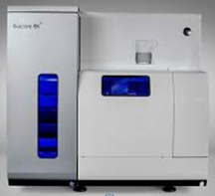
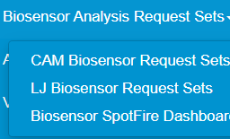
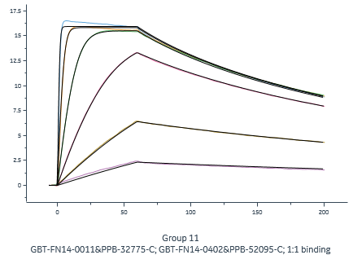

KSQ Biosensor Genedata Workflow
Ligand/Analyte Information
Biosensor Instrument Method
Biosensor Request Created
Processed Data Uploaded into Genedata via Analysis Request System
Biosensor Experiment
Janus Liquid Handler Instructions
Workflow starts and ends with Genedata
Biosensor request facilitates liquid handling/biosensor instrument set up by providing the ligand/analyte information
Request system provides an organized and centralized location for data to be stored and accessed

Slide 4
Creating Biosensor Requests from Purified Material (PPB-IDs)

Slide 5
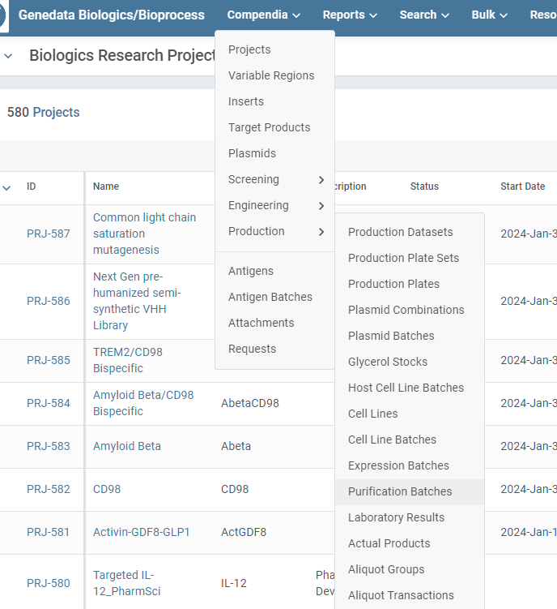
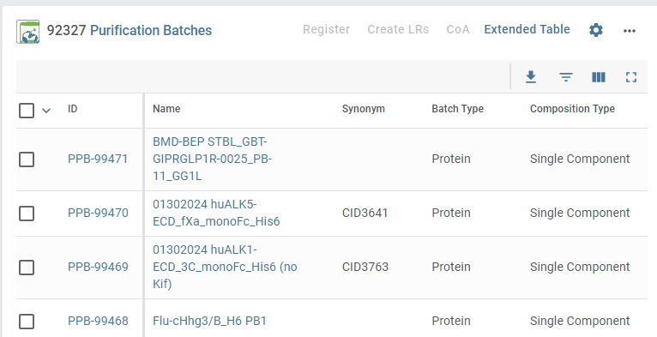
1. Creating Biosensor Requests from Purification Batch Compendia (PPBs)
Genedata Biologics Home → Compendia → Production → Purification Batches
Select Filter Panel

Slide 6
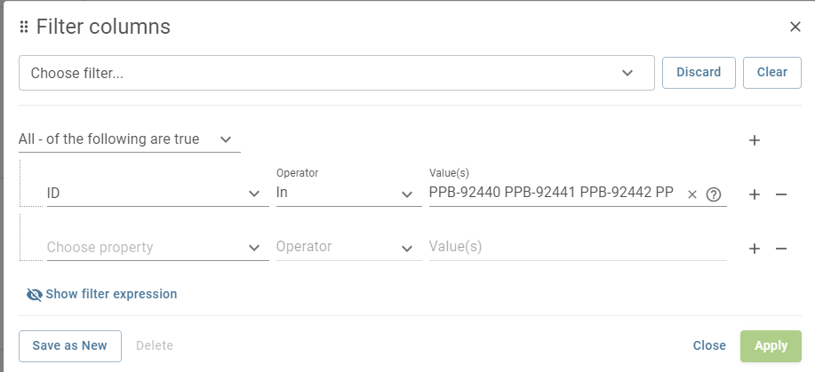
1. Creating Biosensor Requests from Purification Batch Compendia (PPBs)
Set property to “ID”, operator to “In”, and paste a comma or space separated list as values
Note that if you received an excel file with the PPB-IDs listed in the column you can simply select the cells in the column and copy/paste directly into the value field.

Slide 7
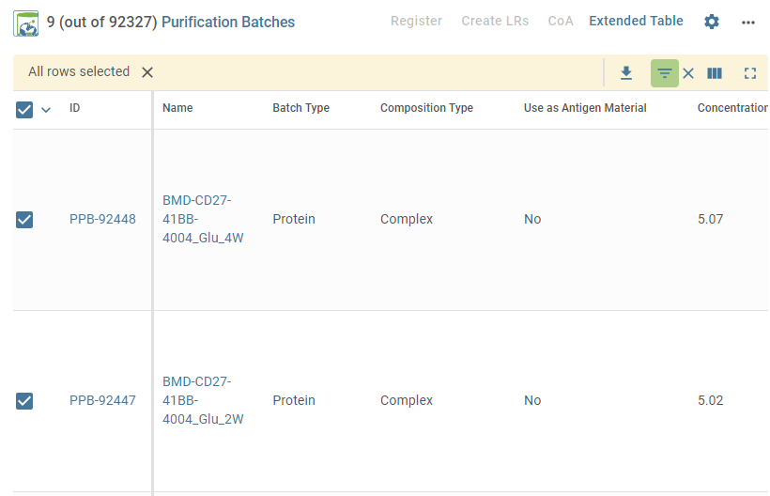
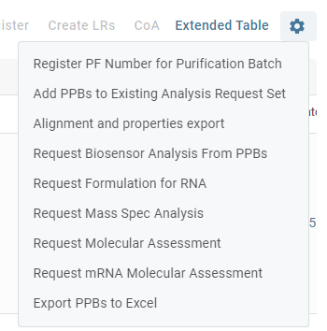
1. Creating Biosensor Requests from Purification Batch Compendia (PPBs)
Pressing “apply” filters the purification batches, check all PPBs
Gear Icon will allow creation of Biosensor Request from selected PPBs
Indicates filter is applied

Slide 8
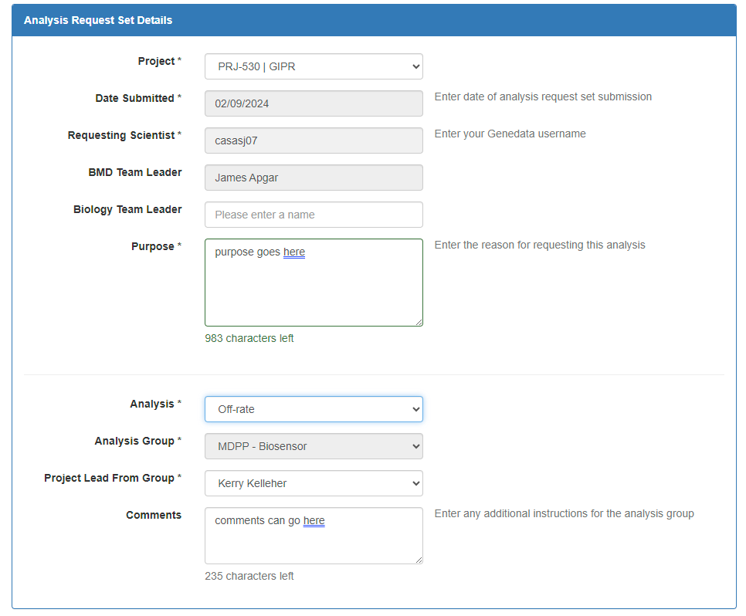
1. Creating Biosensor Requests from Purification Batch Compendia (PPBs)
Enter Analysis Request Set Details within GDBxT
* Fields are required with many being prepopulated
Enter the Purpose of the request. Although not required, please provide the binding partner species, concentration, TP Name, PPB ID, ….
Select the the Analysis type, (K_{D} Values, Off-rate,…)
Select the Project Lead from Group.
Include Comments that will be helpful for the Biosensor scientist to complete the request
Information regarding which instrument was used is not required at this time, but will later be included as part of the laboratory results
Note: A request is a pairing of two proteins (example 1 Ab and 1 Ag), whereas a Request Set may include multiple pairings (example 5 Abs against 1 Ag).

Slide 9
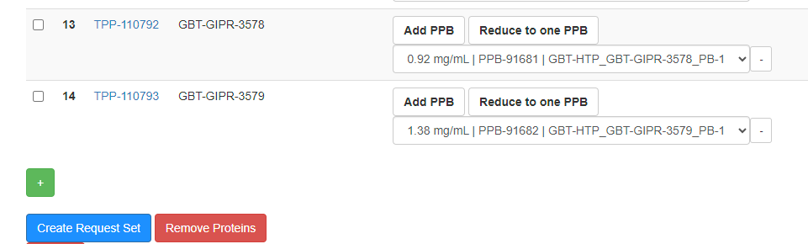
1. Creating Biosensor Requests from Purification Batch Compendia (PPBs)
Complete the Request by Selecting the Protein Purification Batch (PPB)
Submit the Request by Selecting the ‘Create Request Set’ Button
By requesting through PPBs in the purification batch compendia, the exact TPP-PPB hierarchy is automatically supplied for the user
Example of GDBxT Message Displayed after Selecting the ‘Create Request Set’ Button

Slide 10
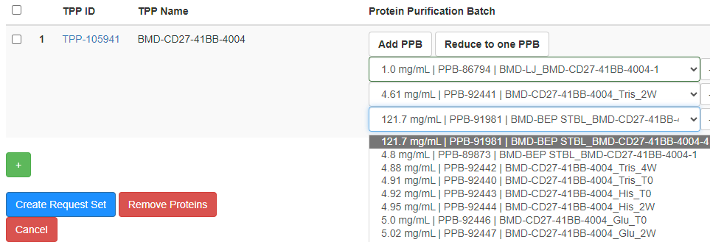
1. Creating Biosensor Requests from Purification Batch Compendia (PPBs)
Occasionally, the user will still need to select the specific PPB from the TPP using this method (ex. child PPBs with the same parental PPB ID/TPP for forced degradation analysis or bispecifics)
(Add or remove a PPB with the same TPP ID)
(Select the PPB for Biosensor analysis. The PPB ID and/or concentration (mg/mL) will help to identify the specific Protein Purification Batch for Biosensor analysis)
Many PPBs
1 TPP
PPB
TPP
PPB
PPB

Slide 11
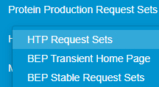
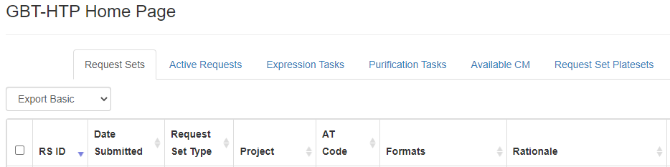
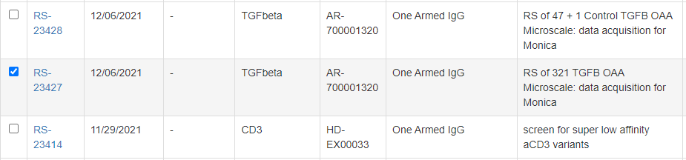
2. Creating Biosensor Requests from HTP Protein Production Request Sets
Select HTP Request Sets within GDBxT
Select the HTP Request Set Name

Slide 12
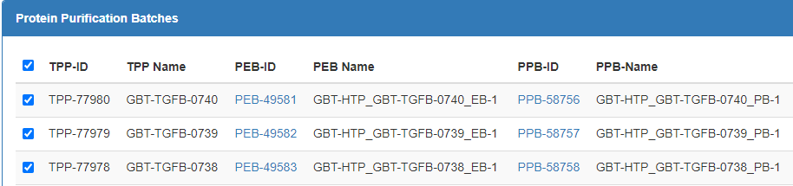
2. Creating Biosensor Requests from HTP Protein Production Request Sets
Select All TPPs under Protein Purification Batches Section (usually found near the bottom of the RS page)
Select the ‘Request Biosensor Analysis’ Button
Most HTP request sets tend to have a 1:1 relationship between TPP and PPB-ID you will not need to manually select the PPB

Slide 13
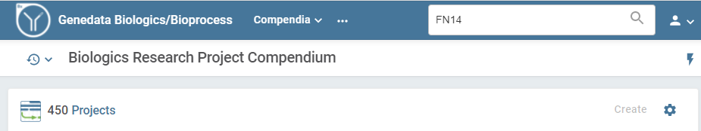
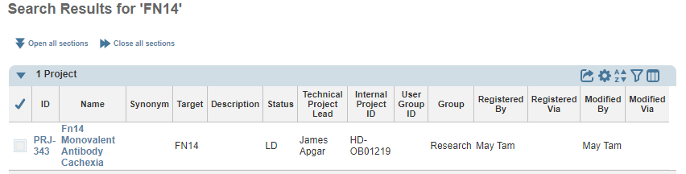
3. Creating Biosensor Requests from Target Products (TP)
Genedata Biologics Home Page Search for the Project
Select the Genedata Project Name

Slide 14
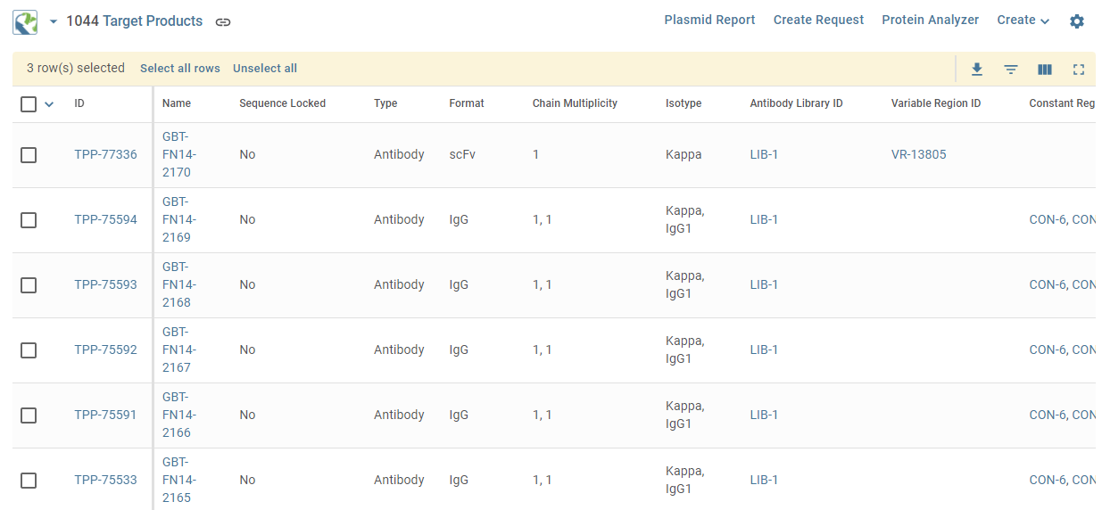
3. Creating Biosensor Requests from Target Products (TP)
Select the Target Products Filter Icon

Slide 15
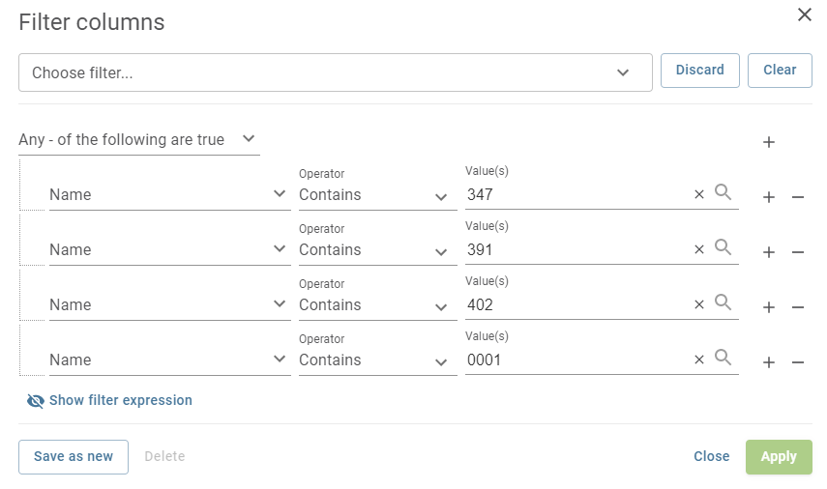
3. Creating Biosensor Requests from Target Products (TP)
Filter for the TP (biotherapeutic) Name
(All, Any)
(Add, remove)
Please note: The aim of this search is to identify the biotherapeutics (example Ab), for Biosensor analysis. It is not necessary to select the other binding partner (example Ag) when creating a Genedata Biosensor request.

Slide 16
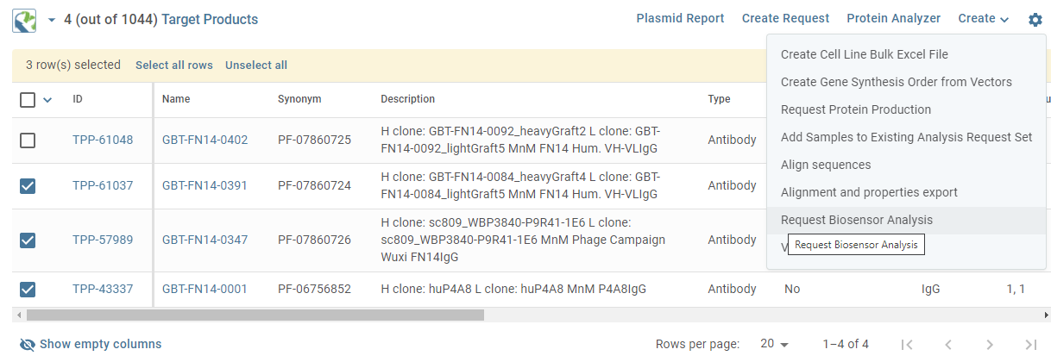
3. Creating Biosensor Requests from Target Products (TP)
Select the Target Product Proteins for Biosensor Analysis
Using the Gear Icon, Select ‘Request Biosensor Analysis’ from the Dropdown List
Since only the TPP was selected, the user will have to manually select the specific PPBs for analysis

Slide 17
Creating Biosensor Requests from Unpurified Material (Hybridoma, TAP sups, etc.)

Slide 18
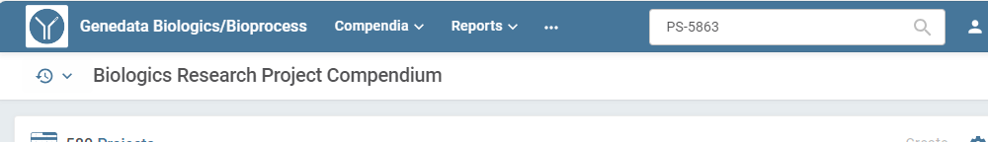
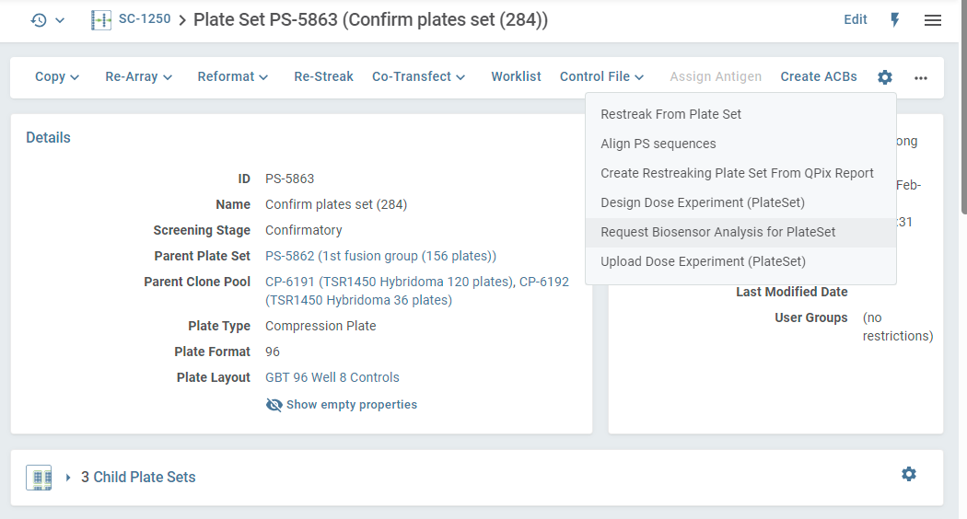
4. Creating Biosensor Requests from Plate Sets (unpurified material)
Search for plate set ID in Genedata Biologics, you can also navigate to the plate set from the screening campaign page
Notes:
This is the only gear icon on the page which has this option
Selecting the specific clones under the well contents section will not affect which clones are brought over to the request set (you can specifically select clones in the next step in GDBxT)
Once on the Plate Set page, select “Request Biosensor Analysis for PlateSet” under the top gear icon

Slide 19
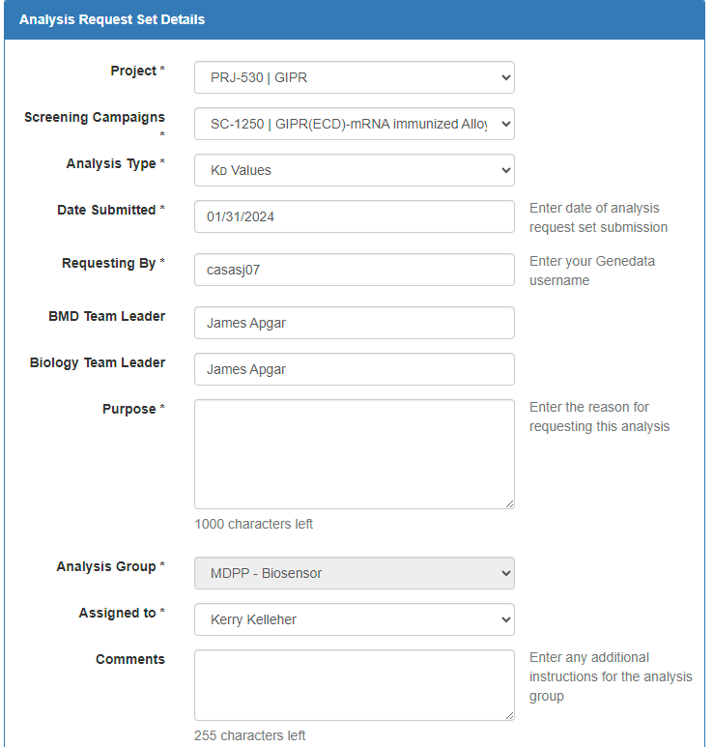
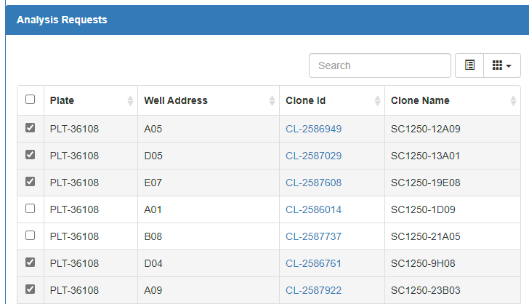
4. Creating Biosensor Requests from Plate Sets (unpurified material)
Enter ARS Details, note that a new screening campaign field is added
Scrolling below the ARS details, you can select the clones you want added to the ARS and press create ARS at the bottom of the page. Note that for plate sets, the unique identifiers in the database are the plate ID and well address.

Slide 20
Modify Existing Biosensor Requests

Slide 21
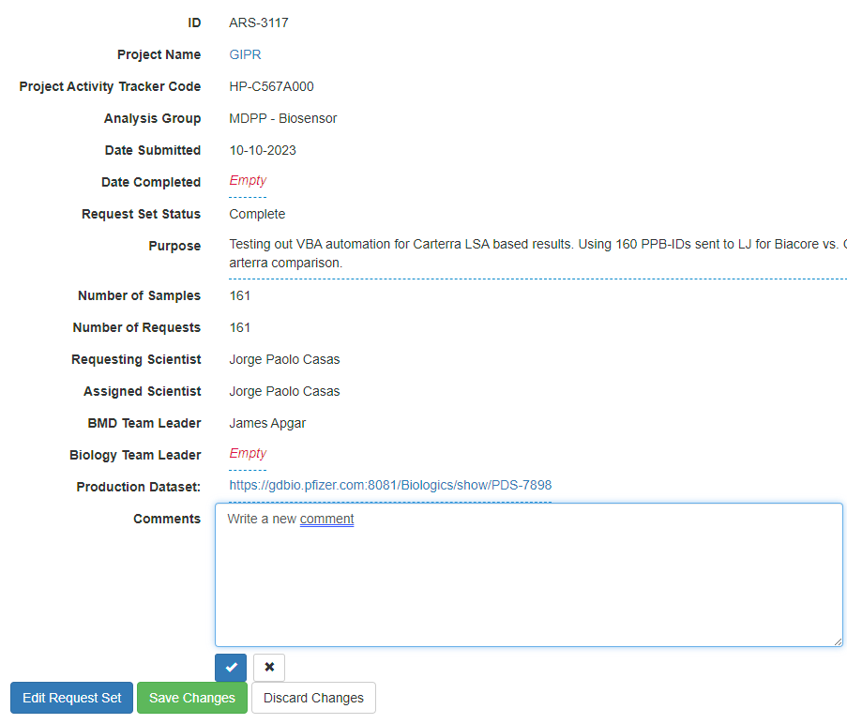
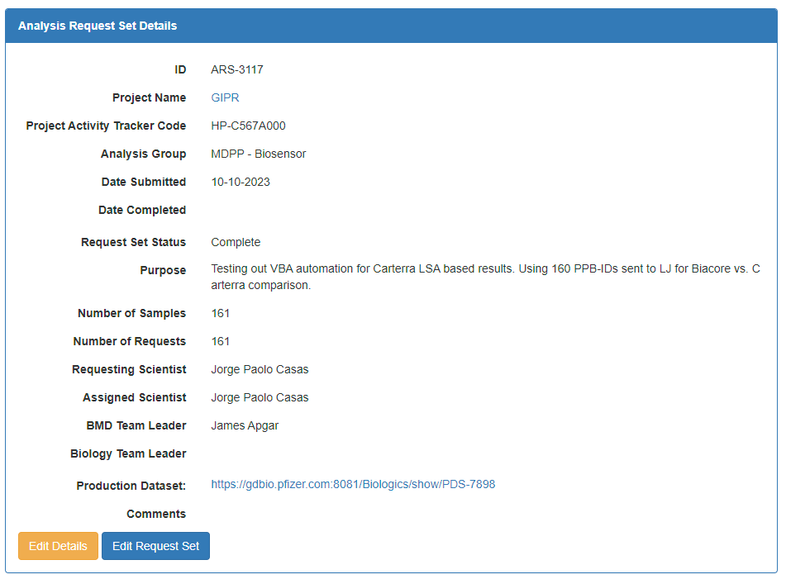
Editing Biosensor Request Set Details
Select the ‘Edit Details’ Button on the Analysis Request Set Details Page
After Editing, Select the Check Mark Button, then the ‘Save Changes’ Button
(Adding more details to the Comments field)
This button will allows for Biosensor group addition of binding partner (s) and control (s), covered in next slide

Slide 22
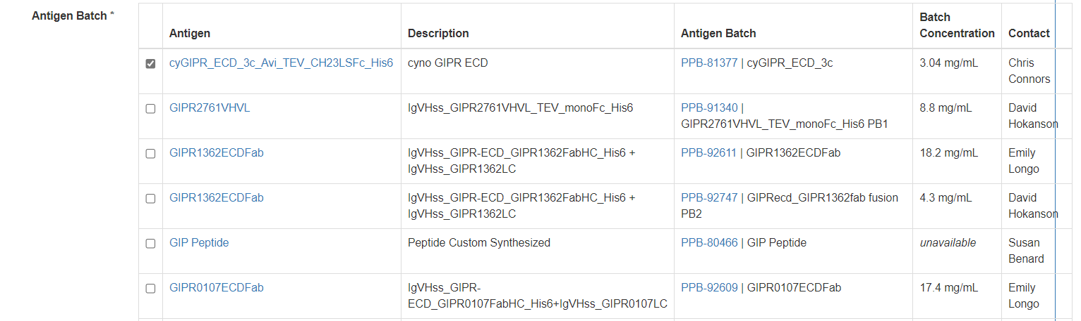
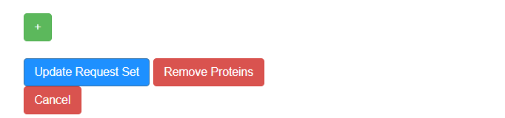
Adding Binding Partner/Antigen
Select the ‘Edit Request Set’ Button on the Analysis Request Set Details Page
Select checkbox corresponding to correct antigen, PPB-ID and concentration have been provided to facilitate selection
Scroll to bottom of page and press “update request set”, now the requests on the main ARS page should display both the ligand and the analyte to complete the pairing

Slide 23
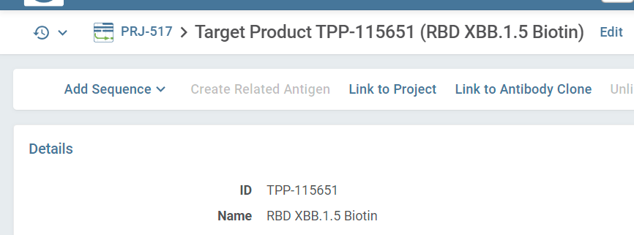
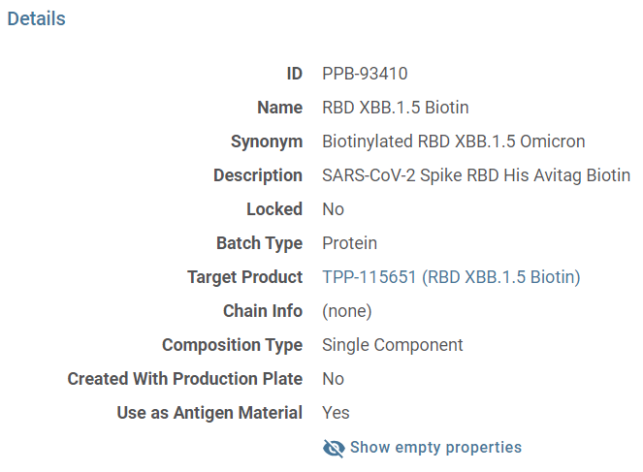
Troubleshooting Adding Binding Partners or Controls
If you need to add a control sample from a different project to the ARS, you will need to link it’s TPP to your current project
If you do not see the desired antigen in the table, ensure that the “Use as Antigen Material” field is marked as “Yes” in the PPB page on Genedata for the antigen to populate in table

Slide 24
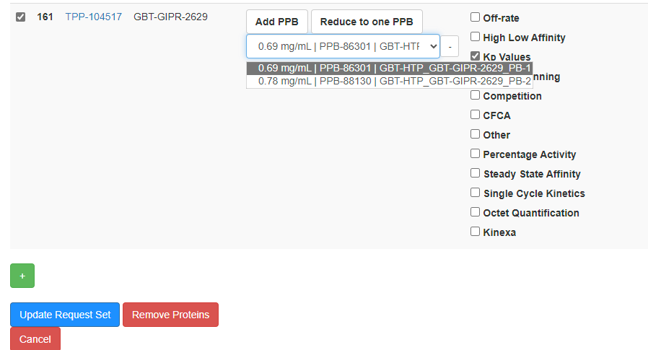
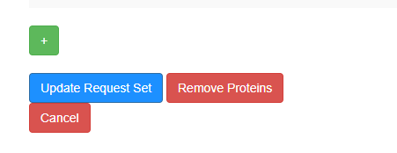
Deleting Requests within a Request Set Details
Select the Request (s) to Delete
Select the ‘Remove Proteins’ Button then the ‘Create Request Set’ Button
Note that users have the option to select multiple analysis types using the checkboxes on the right for a particular TPP. However, we have found that keeping limiting an ARS to a single assay type to a single type works best. If you would like to run additional assays on the same samples, then you can create new ARS.

Slide 25
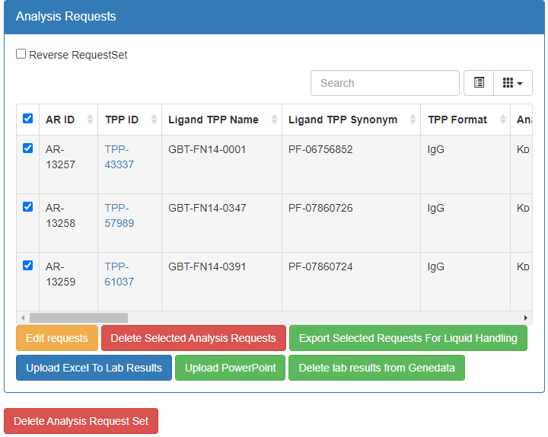
Deleting a Request Set within Request Set Details
To Delete a Submitted Request, Select the ‘Delete Analysis Request Set’ Button
The “Reverse RequestSet” button is provided in the event you plan on reversing the assay (i.e. on the Biacore you would capture the analyte and flow the ligand over the surface).
Pressing this button will cause the biotherapeutic samples to be listed under the analyte column and the antigen/binding partner under the ligand column. However, we have experienced complications uploading our data when this button is pressed so we tend to leave this button unchecked and reverse the samples in our custom macro.

Slide 26
Viewing Genedata Biosensor Assay Results

Slide 27
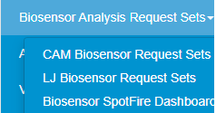
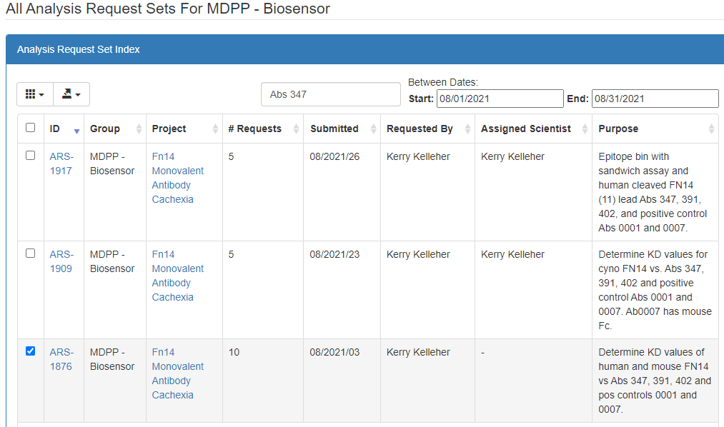
Viewing Biacore Kinetic Assay Results on the Request Set Details Page
Select the appropriate biosensor requests page from the biosensor analysis request sets drop down menu in GDBxT
Search for the ARS with Text (exact match) and Date Field Parameters
Select the ARS ID

Slide 28

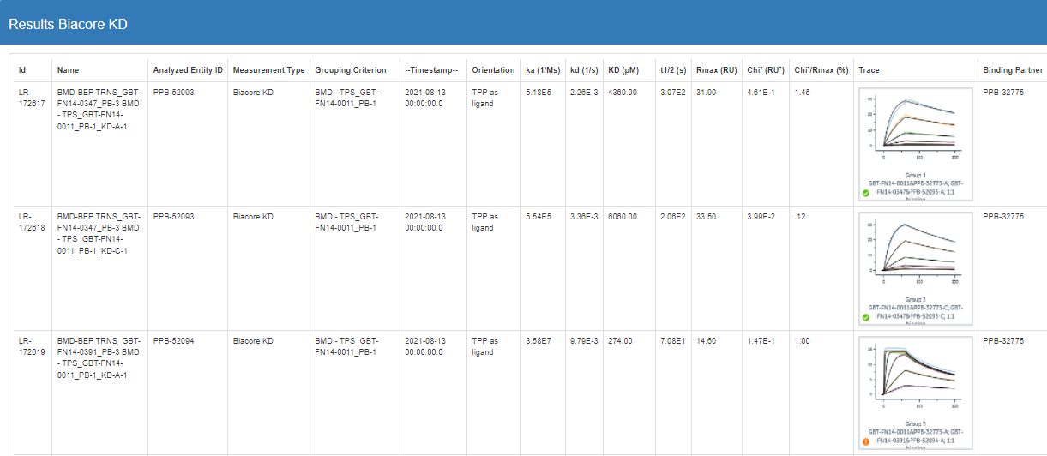
Viewing Biacore Kinetic Assay Results on the Request Set Details Page

Slide 29
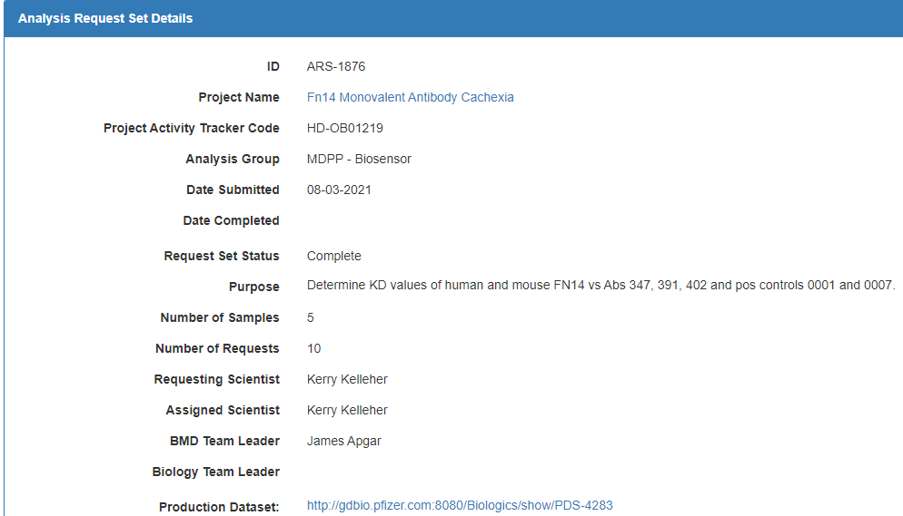
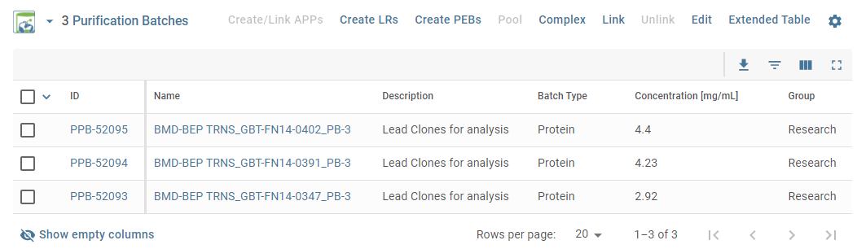
Viewing Biacore Kinetic Assay Results from the Production Dataset (PDS) Page
Select the Production Dataset link on the Biosensor Request Set Details Page
Select the Extended Table Button within the PPB Table

Slide 30
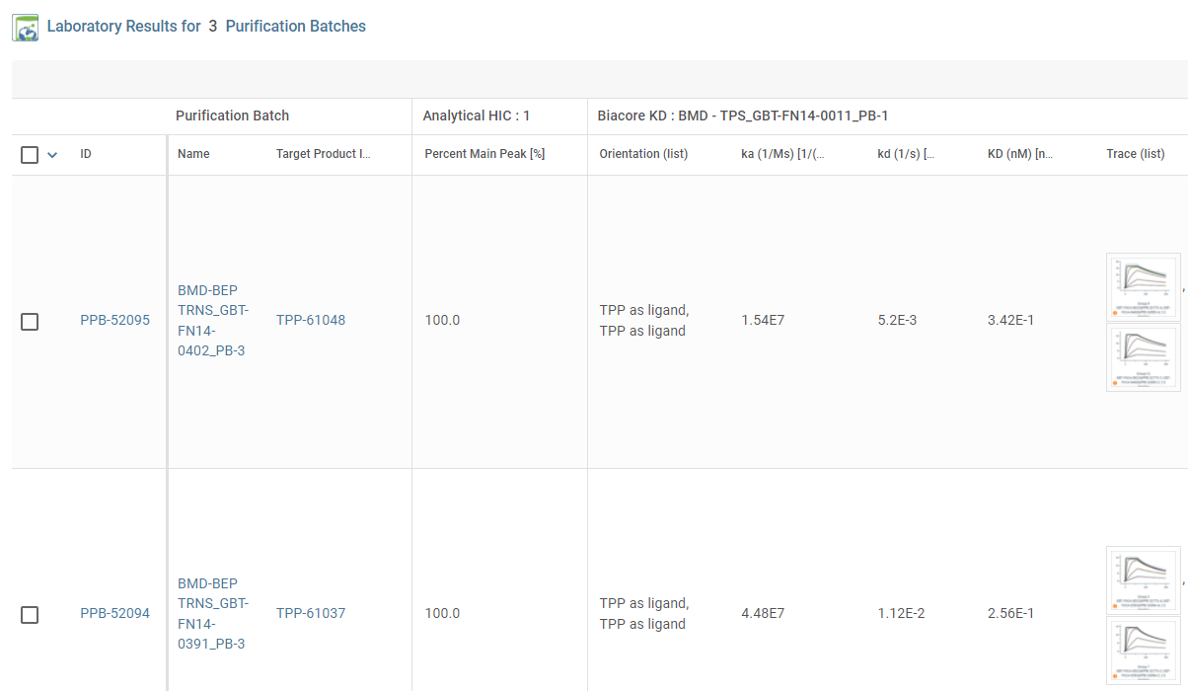
Viewing Biacore Kinetic Assay Results from the Production Dataset (PDS) Page
Select the Sensorgram for Zoom View
(Aggregate Lab Results for PPB in addition to Biacore Assay)

Slide 31

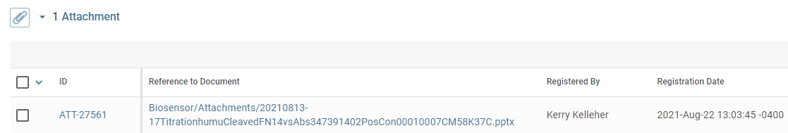

Viewing Biacore PowerPoint Report Results from the Production Dataset (PDS) Page
Select the ‘Attachment’ Button
Select the Reference to Document File Name to View the Biosensor PowerPoint Report
Biosensor PowerPoint Report

